Slide 1
4COSCO11C.2 Web Design and Development
XML and DTD
Week 10

Slide 2
What is XML?
XML stands for EXtensible Markup Language.
Became a W3C Recommendation in 1998.
Subset of Standard Generalized Markup Language (SGML).
XML is a meta-markup language.
You can define your own tags that describe the data being stored.
XML provides a way of sharing information and moving data among different systems.
Notes:
WXML is called a meta markup language.
XML is the Extensible Markup Language. ... It is extensible because it is not a fixed format like HTML (which is a single, predefined markup language). Instead, XML is a metalanguage — a language for describing other languages — which lets you design your own markup languages for limitless different types of documents.

Slide 3
XML Features
XML was designed to incorporate the following features.
Easy to use. XML documents are easy to create - XML authors can define their own tags to describe the data being stored. Because of these descriptive tags, XML documents are also easy to read and understand.
Formal structure. "Well-formed" rules ensure that every XML document meets some minimum expectation of structure and syntax. This makes it easier for applications and processors to deal with XML data.
SGML-compatible. SGML is an internationally accepted standard for describing information but it is too complex for the Internet. XML is a subset of SGML (80% of SGML's functionality but only 20% of the complexity). XML was designed to be used on the Internet.
XML stores data in plain text format. This provides a software-independent and hardware-independent way of storing, transporting and sharing data. It can be read by any tool that can read a text file.
XML enables authors to describe data Allowing the possibility for better organization and classification of information, more intelligent searches and new types of links between data.

Slide 4
The Main Differences Between XML and HTML
Both use tags. However, HTML tags are predefined. With XML you can define your own tags.
HTML was designed to display data in a web page. Therefore, HTML tags specify how data should be displayed. (E.g., "Display this data as a heading " - <h3>...</h/3>).
XML was designed to describe data. There are no built-in presentational features. Therefore, XML uses tags to identify a piece of data rather than specify how to display it. (E.g., <author>...</author>)

Slide 5
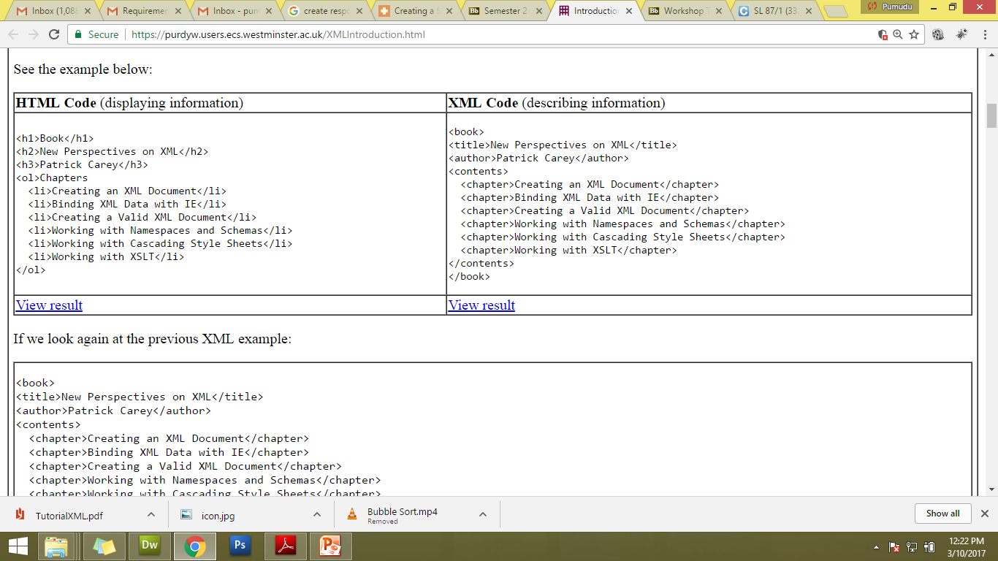
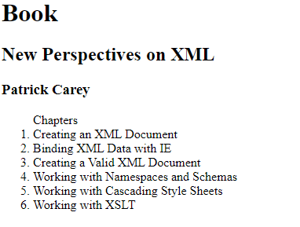
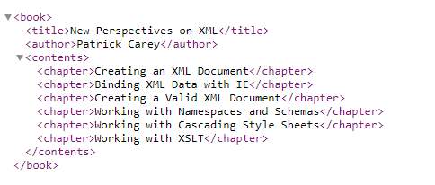
XML vs HTML

Slide 6
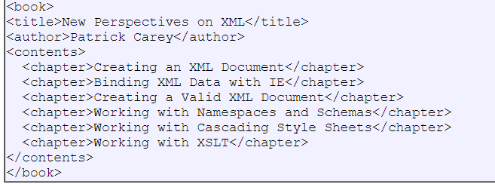
XML vs HTML
If we look again at the previous XML example:
The book has a title, an author and a list of chapters. But still, this XML document does not DO anything. It is just pure information wrapped in XML tags.
Additional software is required to send, receive, process or display the XML.

Slide 7
XML is Extensible
Our XML document can be extended to carry more information. E.g., add more chapter elements or define new tags as required.
The tags in the example above (like <title> and <author>) are not defined in any XML standard. We "invented" them. Also note that although <title> is an existing HTML tag, it does not mean the same thing in XML.
Notes:
You can extend it further

Slide 8
Use of XML
XML is used to Store Data, Share Data and Transport Data. Since XML data is stored in plain text format, XML provides a software and hardware independent way of storing and sharing data.
With XML, data can be exchanged between incompatible systems. We can share data between different types of applications.
XML is often used for distributing data over the Internet.
XML was used to create:
WAP and WML.
The Wireless Markup Language (WML) can be used to create pages that can be displayed in a Wireless Application Protocol (WAP) browser.
XHTML (HTML rewitten in XML).
RSS - web feed formats used to publish frequently changing web content in a standardized format (e.g., news headlines, blog entries etc).

Slide 9
Associated Technologies
Parser - an application that checks the syntax of an XML document.
XML DTDs and Schemas - to validate that an XML document conforms to a predetermined structure.
XSLT - mainly used to convert from one XML format to another.
XPath - used to identify and access elements and attributes in an XML document.
XQuery - used to query large document collections such as those held in databases.

Slide 10
Example XML Document
<?xml version="1.0" encoding="UTF-8"?>
<book>
<title>New Perspectives on XML</title>
<author>Patrick Carey</author>
<contents>
<chapter>Creating an XML Document</chapter>
<chapter>Binding XML Data with IE</chapter>
<chapter>Creating a Valid XML Document</chapter>
<chapter>Working with Namespaces and Schemas</chapter>
<chapter>Working with Cascading Style Sheets</chapter>
<chapter>Working with XSLT</chapter>
</contents>
</book>

Slide 11

XML Document
The first line in the document - the XML declaration - defines the XML version and the character encoding used in the document. In this case the document conforms to the 1.0 specification of XML and uses the UTF-8 (a variety of Unicode).
UTF-8 encoding has a wide range of characters, is supported by all XML parsers and is the default encoding - so the following are the same:
<?xml version="1.0"?>
<?xml version="1.0" encoding="UTF-8"?>
The next line describes the root element of the document (like it was saying: "this document is a book"):

Slide 12
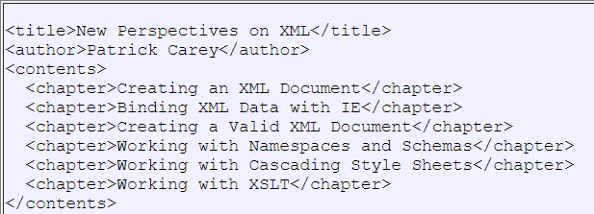

XML Document
The next 10 lines describe 3 child elements of the root (title, author, contents and 5 sub-elements of contents):
And finally the last line defines the end of the root element:

Slide 13
XML Elements
XML Elements have Relationships.
Elements are related as parents and children. For example, in the previous example,
book is the root element. Title, author and contents are child elements of book. Book is the parent element of title, author, and contents. Title, author, and contents are siblings (or sister elements) because they have the same parent.
Elements have Content.
An XML element is everything from (including) the element's start tag to (including) the element's end. It can have element content (contains other elements), mixed content (contains both text and other elements), simple content (contains just text), or empty content. An element can also have attributes.

Slide 14
XML well-formed rules
XML documents must have a root element
(note how the whole XML description is contained between <book> and </book>in the previous example)All XML elements must have a matching closing tag.
What about empty tags? An empty element can be written as: <price> </price> or <price /> (known as self-closing)
XML element names are case sensitive
Does not match: <myElement> </MyElement>
Matches: <myElement> </myElement>
XML elements must be properly nested
Notes:
<b><i>Text</i></b> - properly nested

Slide 15
XML well-formed rules
XML attribute values must be quoted
This is correct: <order date="08/03/2013">.
This is incorrect: <order date=08/03/2013>.
Names must be valid
Names can contain letters, numbers, and other characters
Names must not start with a number or punctuation character
Names must not start with the letters xml (or XML, or Xml, etc)
Names cannot contain spaces
Not allowed: <my Element>
If your document satisfies these rules it is considered "well-formed" and can be used in many ways.

Slide 16
Element Naming
Make tag names descriptive - they should describe the data they contain.
Element names can be as long as you like, but don't exaggerate. Names should be short and simple, like this: <book_title> not like this: <the_title_of_the_book>.
Remember "well-formed" rules - element names are case-sensitive, so the start and end tags must match exactly.
<book>, <BOOK> and <Book> are unrelated elements.

Slide 17
Valid XML
Well-formed documents contain properly written XML tags conforming to XML syntax.
Valid documents not only conform to XML syntax (are well-formed) but also comply to a set of rules defined in a DTD (or schema).
Why validate?
Will enforce a structure and thereby the integrity of the data.
Helps manage large documents.
Notes:
A DTD is a Document Type Definition.
Why Use a DTD?
With a DTD, independent groups of people can agree on a standard DTD for interchanging data.
An application can use a DTD to verify that XML data is valid.

Slide 18
XML - DTD Elements
Example - DTD:
<!ELEMENT shoplist (item+)>
<!ELEMENT item (#PCDATA)>
The DTD defines element called shoplist containing another element called item. How many items?
Item element contains text (parsed character data).
The main blocks of the document. <!ELEMENT ...>
Declaring an internal/external DTD <!DOCTYPE ..>

Slide 19
XML - DTDs - embedded
DTDs are introduced into XML documents by using the <!DOCTYPE> declaration.
A DTD can be embedded in a XML document, e.g.:
<?xml version="1.0"?>
<!DOCTYPE shoplist [
<!ELEMENT shoplist (item+)>
<!ELEMENT item (#PCDATA)>
]>
<shoplist>
<item>Bread </item>
<item>Butter </item>
</shoplist>
Notes:
!DOCTYPE note defines that the root element of this document is note
!ELEMENT note defines that the note element must contain 1 element: “item“ (It can have many items)
!ELEMENT to defines the to element to be of type "#PCDATA"

Slide 20
XML - DTDs - external
A PUBLIC type can be used to locate a DTD from a known repository of DTDs.
The SYSTEM type locates the DTD via a URL. E.g.,
<?xml version="1.0"?>
<!DOCTYPE shoplist SYSTEM "shoplist.dtd">
<shoplist>
<item>Bread</item>
<item>Butter</item>
<item>Tea bags</item>
</shoplist>

Slide 21
Specifying sequence of elements: comma
Comma means?
<!ELEMENT module (code, name)>
<!ELEMENT code (#PCDATA)>
<!ELEMENT name (#PCDATA)>
The following would be valid:
<module>
<code>hsc1 </code> <name>Business </name>
</module>
Notes:
When children are declared in a sequence separated by commas, the children must appear in the same sequence in the document.

Slide 22
Specifying sequence of elements: + ? *
!ELEMENT filmlist (film+)>
<!ELEMENT film (title+, year?, actor*)>
<!ELEMENT title (#PCDATA)>
<!ELEMENT year (#PCDATA)>
<!ELEMENT actor (#PCDATA)>
Notes:
The + sign in the example above declares that the child element "message" must occur one or more times inside the "note" element.
The * sign in the example above declares that the child element "message" can occur zero or more times
The ? sign in the example above declares that the child element "message" can occur zero or one time inside the "note" element.

Slide 23
Would the following example be valid?
<filmlist>
<film>
<title>Atonement </title>
<year>2007</year>
<actor>James McAvoy </actor>
<actor>Keira Knightley </actor>
</film>
<film>
<title>Pan's Labyrinth </title>
<title>El laberinto del fauno </title>
</film>
</filmlist>

Slide 24
Specifying sequence of elements: |
Pipe stem (|) means?
<!ELEMENT dessert (gateau | fruit)>
<!ELEMENT gateau (#PCDATA)>
<!ELEMENT fruit (#PCDATA)>
Valid?
Ex:01
<dessert> <gateau>Lemon Cake</gateau> </dessert>
<dessert> <fruit>Strawberries</fruit> < /dessert>
Ex:02
<dessert>
<gateau>Lemon Cake</gateau>
<fruit>Strawberries</fruit>
< /dessert>
Notes:
The example above declares that the "note" element must contain a "to" element, a "from" element, a "header" element, and either a "message" or a "body" element.

Slide 25
Elements
Parentheses ( ) - used for grouping:
<!ELEMENT first_course ((bread,soup)|starter)>
A heading is made up of a title and an address in any order:
<!ELEMENT heading (( title, address)| (address, title))>
To create an EMPTY element:
<!ELEMENT img EMPTY>
In XML document:
<img />

Slide 26
Exercise
Create a XML file to store details of employees.
File can have details of at least a single employee and each employee should have following details.
Name – contains first name and last name where it is a must to have firstName and an optional secondName
Address - must have exactly one address
Mobile – optional. But one employee can have many mobile numbers as well.
Create an external DTD file to satisfy above requirements
Notes:
<!DOCTYPE employeelist
[
<!ELEMENT employeelist (employee+)>
<!ELEMENT employee(name,address,mobile*)>
<!ELEMENT name(firstName, secondName?)>
<!ELEMENT firstName (#PCADATA)>
<!ELEMENT secondName(#PCADATA)>
<!ELEMENT address (#PCADATA)>
<!ELEMENT mobile (#PCADATA)>
]>

Slide 27
Validating XML Files
Online validators
http://www.xmlvalidation.com/
https://www.w3schools.com/xml/xml_validator.asp
Offline validators
Browser extensions
Standalone tools

Slide 28
Recap - XML and DTDs:
Well-formed documents vs Valid documents
Contents of DTD elements:
Elements containing child elements: <!ELEMENT shoplist (item+)>
Elements containing text ("Parsed Character Data"): <!ELEMENT item (#PCDATA)>
EMPTY elements: <!ELEMENT picture EMPTY>
Combination rules:
A, B
A?
A+
A*
A | B
To declare an internal or external DTD <!DOCTYPE ... >
Note the syntax for writing comments in XML is similar to that of HTML. <!-- This is a comment -->

Slide 29
XML Attributes
XML elements can have attributes in the start tag, just like HTML. From HTML you will remember this:
<IMG SRC="computer.gif">.
In HTML (and in XML) attributes are name-value pairs that provide additional information about an element:
Attributes often provide information that is not a part of the data. In the example below, the file type is irrelevant to the data, but important to the software that wants to manipulate the element:
<file type="gif">computer.gif</file>

Slide 30
Use of Elements vs. Attributes
Data can be stored in child elements or in attributes. Take a look at these examples:
In the first example gender is an attribute. In the last, gender is a child element. Both examples provide the same information.
There are no rules about when to use attributes, and when to use child elements. Use child elements if the information feels like data. Use attributes when the information is data about data (further describes element). Also, it is easier to carry out searches based on elements.
<person gender="female">
<firstname>Anne</firstname>
<lastname>Smith</lastname>
</person>
<person>
<gender>female</gender>
<firstname>Anne</firstname>
<lastname>Smith</lastname>
</person>

Slide 31
Viewing XML Files
Raw XML files can be viewed in most browsers. However, to make XML documents display as web pages, you will have to add display information with support software.
Open the XML file (typically by double-clicking on the file) - The XML document will be displayed with color-coded root and child elements. A plus (+) or minus sign (-) to the left of the elements can be clicked to expand or collapse the element structure.
To view the raw XML source (without the + and - signs), select "View Page Source" or "View Source" from the browser menu.

Slide 32
Why Does XML Display Like This?
XML documents do not carry information about how to display the data.
Since XML tags are "invented" by the author of the XML document, browsers do not know if a tag like <table> describes an HTML table or a dining table.
Without any information about how to display the data, most browsers will just display the XML document as it is.
We will take a look at using CSS to display the data.

Slide 33
Displaying XML with CSS
With CSS (Cascading Style Sheets) you can add display information to an XML document.
Below is an example of how to use a CSS style sheet to format an XML document:
<?xml version="1.0" encoding="UTF-8"?>
<?xml-stylesheet type="text/css" href="book.css"?>
<title>New Perspectives on XML</title>
<author>Patrick Carey</author>
<contents>
<chapter>Creating an XML Document</chapter>
<chapter>Binding XML Data with IE</chapter>
<chapter>Creating a Valid XML Document</chapter>
<chapter>Working with Namespaces and Schemas</chapter>
<chapter>Working with Cascading Style Sheets</chapter>
<chapter>Working with XSLT</chapter>
</contents>

Slide 34
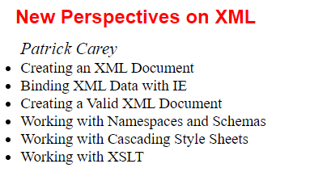
Displaying XML with CSS

Slide 35
Review Questions
Which of the following is false? XML is used to:
Store data
Share data
Transport data
Style data
What is a Schema or a DTD used for: [2 answers are correct]
to transform an XML document to a general format like PDF
to define the structure of XML documents
to allow validation of an XML document
to check the well-formedness of an XML document

Slide 36
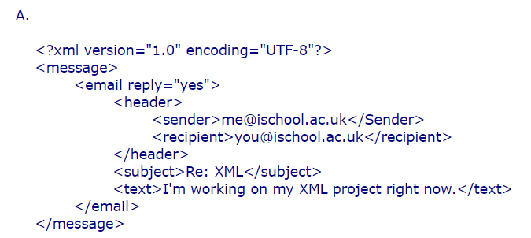
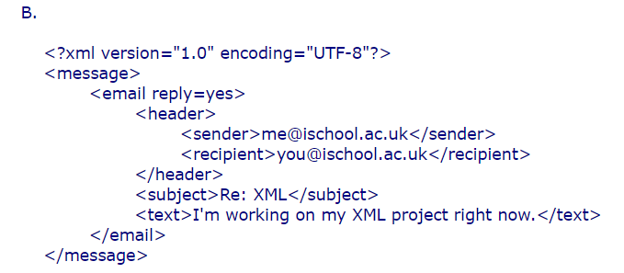
Review Questions
Which of the following examples (A to E) are well-formed? If an example is not well-formed, state why.

Slide 37
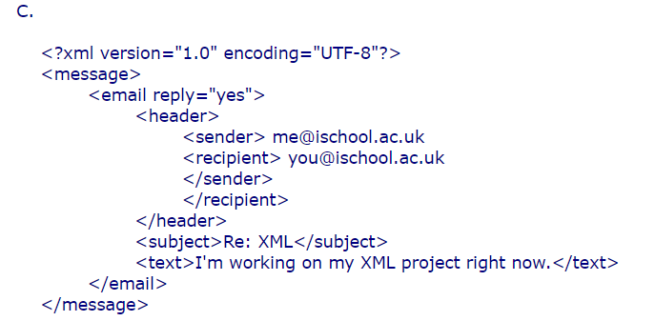
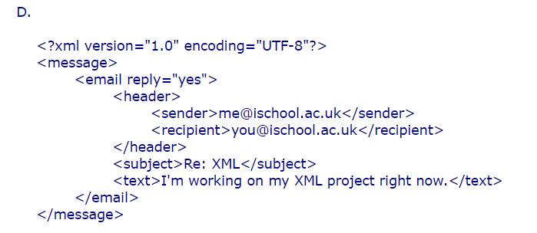
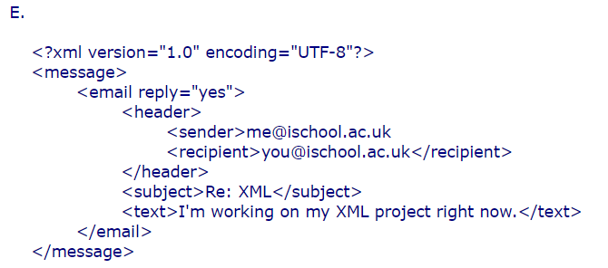
Review Questions

